Slide 1
Chapter 7
Arrays
Dai Liyun
dailiyun@swu.edu.cn

Slide 2
Chapter 7
7.1 INTRODUCTION TO ARRAYS
7.2 ARRAYS IN FUNCTIONS
7.3 PROGRAMMING WITH ARRAYS
7.4 MULTIDIMENSIONAL ARRAYS

Slide 3

7.1 INTRODUCTION TO ARRAYS Declaring and Referencing Arrays
int score[5];
score[0], score[1], score[2], score[3], score[4]ss
int next, score[5], max;
int n = 2;
score[n + 1] = 99;
Usage:
Usage:

Slide 4
Use for Loops with Arrays
for (i = 0; i < 5; i++)
cout << score[i] << " off by "
<< (max - score[i]) << endl;
（1）Array Indexes Always Start with Zero
（2）Array Index Out of Range
Note：

Slide 5
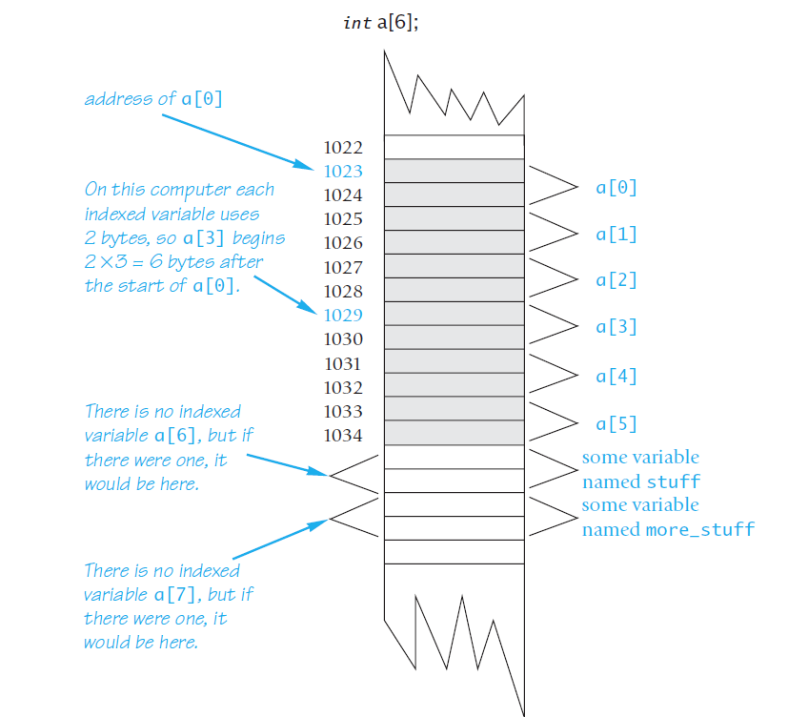
An Array in Memory

Slide 6
Initializing Arrays
For example,
int children[3] = {2, 12, 1};
This declaration is equivalent to the following code:
int children[3];
children[0] = 2;
children[1] = 12;
children[2] = 1;

Slide 7
Initializing Arrays
For example, the following declaration
int b[] = {5, 12, 11};
is equivalent to
int b[3] = {5, 12, 11};

Slide 8
ARRAYS IN FUNCTIONS

Slide 9
Review
3. Identify any errors in the following array declarations.
a. int x[4] = { 8, 7, 6, 4, 3 };
b. int x[] = { 8, 7, 6, 4 };
c. const int SIZE = 4; int x[SIZE];

Slide 10
7. What is wrong with the following piece of code?
int sample_array[10];
for (int index = 1; index <= 10; index++)
sample_array[index] = 3*index;

Slide 11
Indexed Variables as Function Arguments
int i, n, a[10];
my_function takes one argument of type int,
my_function(n);
Since an indexed variable of the array a is also a variable of type int, just like n, the following is equally legal:
my_function(a[3]);
There is one subtlety that does apply to indexed variables used as
arguments. For example, consider the following function call:
my_function(a[i]);

Slide 12
Entire Arrays as Function Arguments
//Uses iostream:
void fill_up(int a[], int size)
{
using namespace std;
cout << "Enter " << size << " numbers:\n";
for (int i = 0; i < size; i++)
cin >> a[i];
size--;
cout << "The last array index used is " << size << endl;
}

Slide 13
The const Parameter Modifier
void show_the_world(const int a[], int size_of_a)
//Precondition: size_of_a is the declared size of the array a.
//All indexed variables of a have been given values.
//Postcondition: The values in a have been written
//to the screen.
{
cout << "The array contains the following values:\n";
for (int i = 0; i < size_of_a; a[i]++)
cout << a[i] << " ";
cout << endl;
}

Slide 14
Test
void too2(int a[], int how_many)
{
for (int index = 0; index < how_many; index++)
a[index] = 2;
}
Which of the following are acceptable function calls?
int my_array[29];
A: too2(my_array, 29);
B: too2(my_array, 10);
C: too2(my_array, 55);

Slide 15
PROGRAMMING WITH ARRAYS
fill_array(score, MAX_NUMBER_SCORES, number_used);
double compute_average(const int a[], int number_used)
void show_difference(const int a[], int number_used)
Search int search(const int a[], int number_used, int target)

Slide 16
Sorting an Array
void sort(int a[], int number_used);
//Precondition: number_used <= declared size of the array a.
//Array elements a[0] through a[number_used-1] have values.
The function sort rearranges the elements in array a so that after the function call is completed the elements are sorted as follows:
a[0] ≤ a[1] ≤ a[2] ≤ ... ≤ a[number_used - 1]

Slide 17
selection sort algorithm
for (int index = 0; index < number_used; index++)
Place the indexth smallest element in a[index]

Slide 18
7.2 CALL-BY-REFERENCE PARAMETERS
void get_input(double& f_variable)
{
cout << "I will convert a Fahrenheit temperature"
<< " to Celsius.\n"
<< "Enter a temperature in Fahrenheit: ";
cin >> f_variable;
}
double a=1.0;
get_input(a);
cout<< a;
Input: 20.22

Slide 19
7.2 CALL-BY-REFERENCE PARAMETERS
void get_input(double& f_variable)
{
cout << "I will convert a Fahrenheit temperature"
<< " to Celsius.\n"
<< "Enter a temperature in Fahrenheit: ";
cin >> f_variable;
}
double a=1.0;
get_input(a);
cout<< a;
output: 20.22

Slide 20
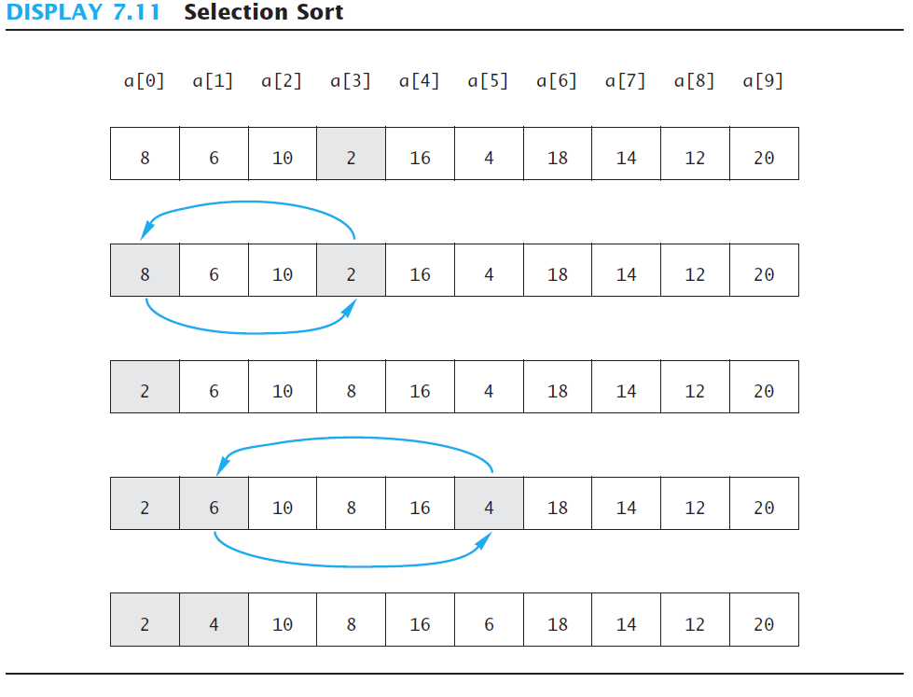
selection sort algorithm

Slide 21
selection sort algorithm
for (int index = 0; index < number_used; index++)
find the smallest element a in [index, number_used)
swap_values(a, a[index])
int index_of_smallest(const int a[], int start_index, int number_used);
void swap_values(int& v1, int& v2);

Slide 22
MULTIDIMENSIONAL ARRAYS

Slide 23
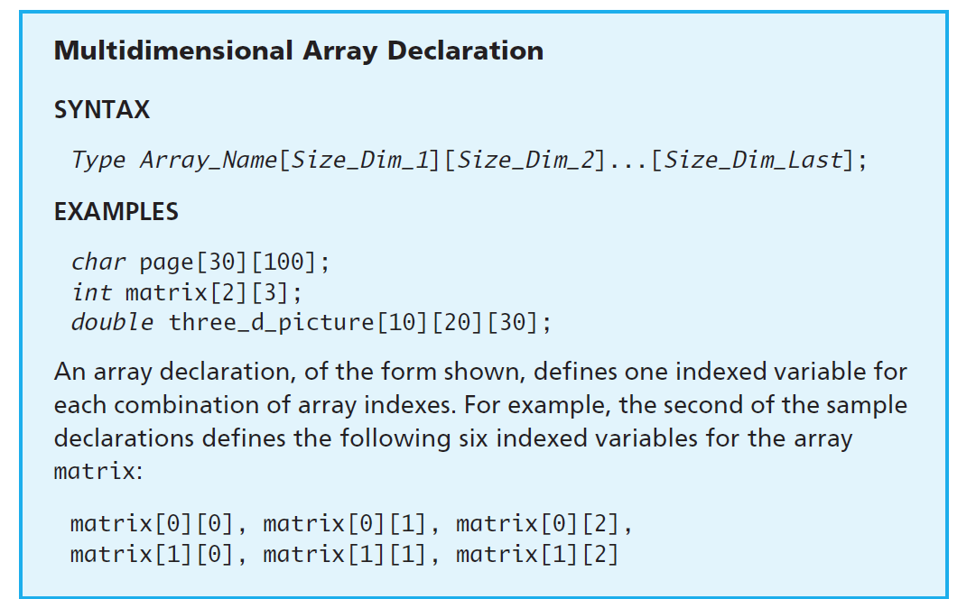
Multidimensional Array Declaration

Slide 24
Test
Page 440 exercise 11

Slide 25
Project
Computing the number of occurrences of the highest number of 10 roles in novel “Romeo and Juliet”. And ploting the result in SVG file.

Slide 26
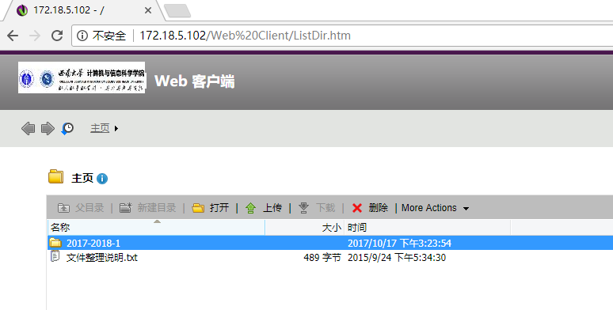
Project submit
172.18.5.102
User: dailiyun
Password: dailiyun

